Slide 1
Chapter 1. Computer System Overview
CSci 474: Operating Systems Instructor: Dr. Jun Kong

Slide 2
Computer components
Processor: central processing unit (CPU)
Main memory: store data and programs
I/O module: move data between the computer and external environment
System bus: provide for communication among processors, main memory and I/O modules
www.menti.com: 8265591

Slide 3
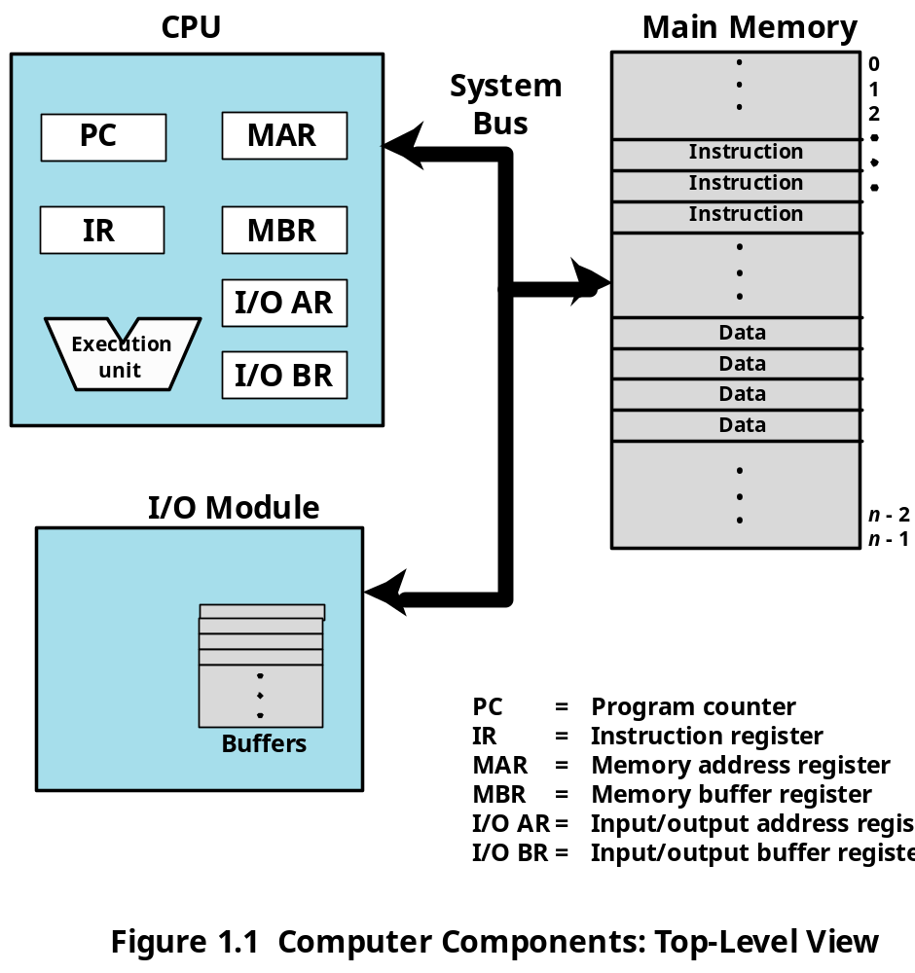
Computer components

Slide 4
Registers
User-visible registers
  A programmer can make use of registers to reduce memory references
Control and status registers
  Used by processor to control system operation
  Used by privileged operating-system routines to control the execution of programs

Slide 5
User-visible register
Data register: general-purpose registers for working with data
Address register
  Segment pointer: When memory is divided into segments, memory is referenced by a segment and an offset
  Index register: Add an index to a base value to get the effective address
  Stack pointer: Point to top of stack

Slide 6
Control and status register
Program counter (PC): address of the next instruction
Instruction Register (IR): current instruction
Program status word (PSW): status information in relation to the program currently being executed

Slide 7
Program status word
Condition codes are bits set by the processor based on results of operations (overflow or zero)
  They cannot be altered by explicit reference because they are intended for feedback regarding the results of instruction execution
Interrupt enable/disable
Supervisor/user mode

Slide 8

PSW Example
Program Status Word
ID
VIP
VIF
AC
VM
RF
NT
IOPL
OF
Identification flag
Virtual interrupt pending
Virtual interrupt flag
Alignment check
Virtual 8086 mode
Resume flag
Nested task flag
I/O privilege level
Overflow flag
DF
IF
TF
SF
ZF
AF
PF
CF
Direction flag
Interrupt enable flag
Trap flag
Sign Flag
Zero flag
Auxiliary carry flag
Parity flag
Carry flag

Slide 9
Instruction execution
Processor reads instructions from memory (fetch)
Processor executes each instruction
Main Memory
Execute
CPU
Fetch Instruction

Slide 10
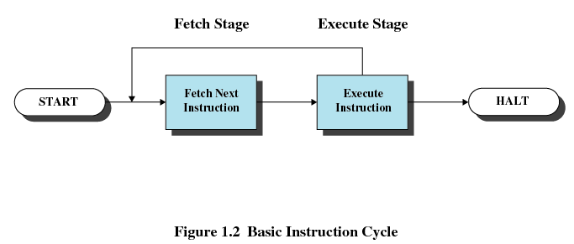
Instruction cycle
An “instruction cycle” is the processing of a single instruction, involving the fetch cycle and execute cycle.

Slide 11
Instruction cycle
The processor fetches the instruction from memory into IR
The instruction in the IR is decoded to determine what the processor should do
After each fetch, the PC is normally incremented so that it is ready to fetch the next instruction.

Slide 12
Instruction actions
Processor-memory
  Transfer data between processor and memory
Processor-I/O
  Data transferred to or from a peripheral device
Data processing
  Arithmetic or logic operation on data
Control
  Alter sequence of execution

Slide 13
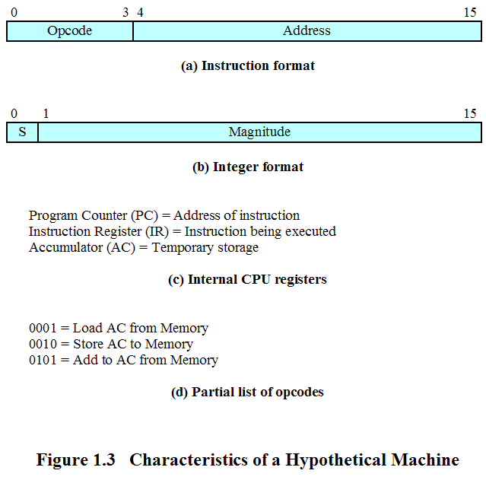
Instruction and Data Formats Example
If part of the instruction is an opcode and part an address, then the portion set aside for the opcode determines how many opcodes there can be, and the portion set aside for the address determines how much memory is directly addressable.
For example, if 4 bit opcodes, then only 16 opcodes are possible.

Slide 14
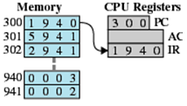
Example of Program Execution
0x01 = Load AC from Memory
0x02 = Store AC to Memory
0x05 = Add to AC from Memory

Slide 15
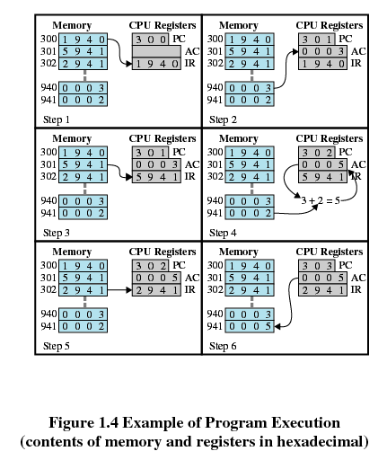
Example of Program Execution
Fetch stage
Execute stage
0x01 = Load AC from Memory
0x02 = Store AC to Memory
0x05 = Add to AC from Memory

Slide 16
Interrupts
Interrupts are a mechanism for interrupting the processor’s execution in order to do something else.
Interrupts improve processor efficiency by notifying the processor of an event versus making the processor wait.
That frees the processor to do other processing.

Slide 17
Interrupts
An example of using interrupts to improve processor efficiency is in processing I/O commands.
Most I/O devices are much slower than the processor.
Rather than having the processor wait for an I/O to finish, the processor could continue processing and be interrupted when an I/O finishes. This is much more efficient.

Slide 18
Common types of interrupts
Program – instruction exceptions:
  arithmetic overflow
  division by zero
  execute illegal instruction
  reference outside user’s memory space
Timer – system timer
I/O – completion of I/O or I/O error.
Hardware failure – power failure or memory parity error.

Slide 19
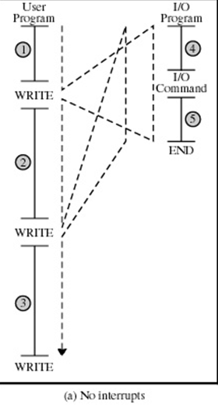
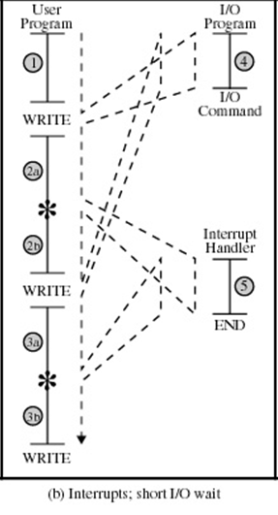
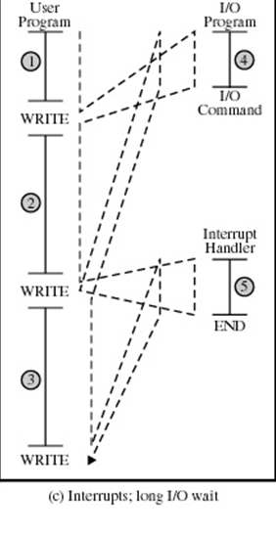

Slide 20
Time
1
1
4
4
Processor
Wait
2a
I/O Operation
I/O Operation
5
5
Interrupt handler
2b
2
4
4
3a
I/O Operation
Processor
Wait
I/O Operation
5
Interrupt handler
5
3b
3
Without interrupts
With interrupts (short I/O)
Program timing

Slide 21
Time
1
1
4
4
Processor Wait
2
I/O Operation
I/O Operation
Processor Wait
Interrupt handler
5
5
2
4
4
3
I/O Operation
Processor Wait
Processor Wait
I/O Operation
Interrupt handler
5
5
3
With interrupts (long I/O)
Without interrupts
Program timing

Slide 22
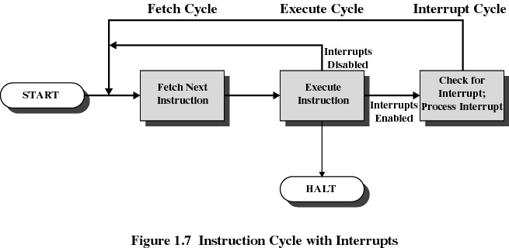
Instruction cycle with Interrupts
Interrupt cycle:
  After instruction execution, the processor checks to see if an interrupt has occurred.
  If so, it executes an “Interrupt Handler”, which processes the interrupt.
  The system state (the registers) on the stack must be saved before executing the interrupt handler.

Slide 23
Interrupt Processing
Memory
When an interrupt occurs, the CPU
switches from the program
to the interrupt handler.
Stack
Interrupt handler
CPU
System state is saved on the stack so that execution can resume in the program when the handler is finished as if the interrupt had never occurred.
Program

Slide 24
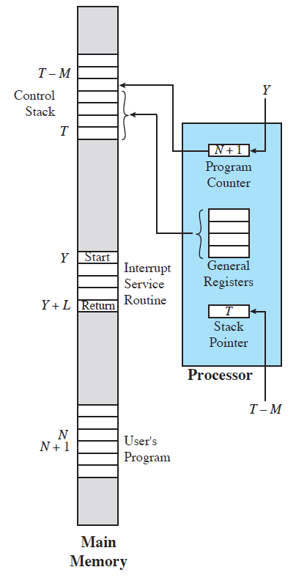
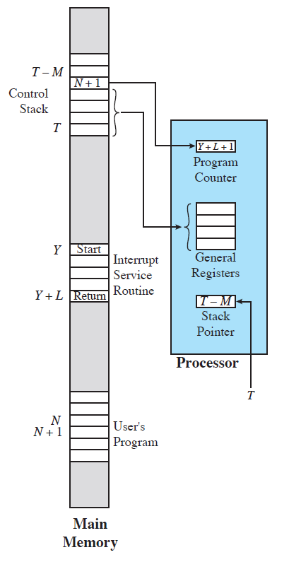
Changes in Memory and Registers for an Interrupt
(a) Interrupt occurs after instruction at location N
(b) Return from interrupt

Slide 25
Multiple Interrupts (menti: 39848827)
It is possible for an interrupt to occur while another interrupt is being processed.
Two solutions:
  Disable interrupts while processing an interrupt. Disadvantage: high-priority interrupt may wait too long and lose data while waiting for a low-priority interrupt to finish.
  Interrupt Priorities: let high-priority interrupt execute when processing low-priority interrupts. Interrupt low-priority interrupts just like interrupting a program.

Slide 26
Multiprogramming
Processor has more than one program to execute
The sequence, in which the programs are executed, depends on their relative priority and whether they are waiting for I/O
After an interrupt handler completes, control may not return to the program that was executing at the time of the interrupt

Slide 27
Memory hierarchy
Generally these tradeoffs apply to memory:
  Faster access time, greater cost per bit
  Greater capacity, smaller cost per bit
  Greater capacity, slower access time.

Slide 28
Motivation
The computer system designer wants greater capacity for larger programs and reduced cost per bit, but also wants fast access times which is not a characteristic of greater capacity.
Therefore, a single memory solution isn’t appropriate, that is why a hierarchy of memory types is used.

Slide 29
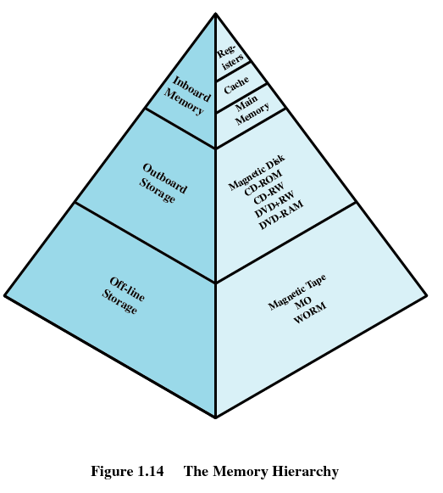
Decr. cost per bit
Incr. capacity
Incr. access time
Decr. freq. of access by the processor.

Slide 30
Why does a Memory Hierarchy work?
Locality of reference: program execution of instructions and data occur in clusters.
Therefore, as long as a cluster is loaded high up in the memory hierarchy, execution is fast until that cluster is finished and the next cluster is loaded.
If we think of program execution as a series of clusters which can load into the highest memory level and execute, then we can see that program execution can be quite fast.

Slide 31
Cache Memory
Most processors can execute instructions faster than they can be retrieved from main memory.
Cache memory sits between the processor and main memory, and exploits the principle of “locality of reference” by keeping a “working set” of instructions and data in its small but high-speed memory.

Slide 32
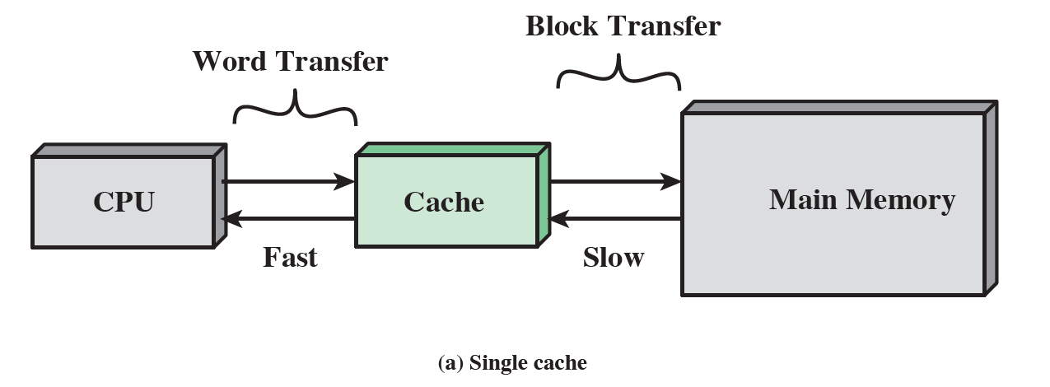
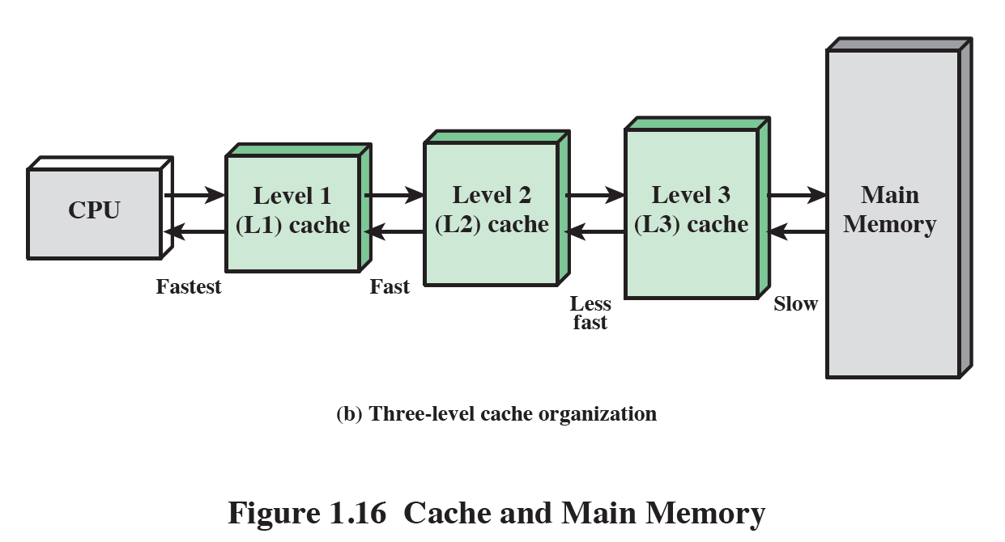

Slide 33
Cache Principles
When the processor fetches an instruction, a block is read into the cache.
When the next instruction is fetched, there is a high probability it is contained in the same cache block, which can be accessed quickly.
Caches typically hold several blocks at a time.
This can result in very fast processor execution.

Slide 34
Cache Design
Cache size
  Small caches have a significant impact on performance
Block size
  The unit of data exchanged between cache and main memory

Slide 35
Cache Design
Mapping function
  Determines which cache location the block will occupy
Replacement algorithm
  Determines which block to replace
  Least-Recently-Used (LRU) algorithm

Slide 36
Cache Design
Write policy dictates when the memory write operation takes place
  The writing can occur every time block is updated
  The writing can occur only when block is replaced
    Minimizes memory write operations
    Leaves main memory in an obsolete state

